Slide 1

Dev Mobile Project: Twitter (X)
Group 4 : Lý Nhật Huy (Cap)
Tạ Minh Đức
Nguyễn Như Duy
Lê Tuấn Đạt
Nguyễn Tiến Đạt
Nguyễn Minh Hoàng (Presenter)
1

Slide 2
Table of contents
01
02
04
03
Preview
Development
Demo
Conclusion
2

Slide 3


01
Preview

Slide 4
Five Main Fragments
Login
Home
Community
Search
Notification
Chat Box

Slide 5
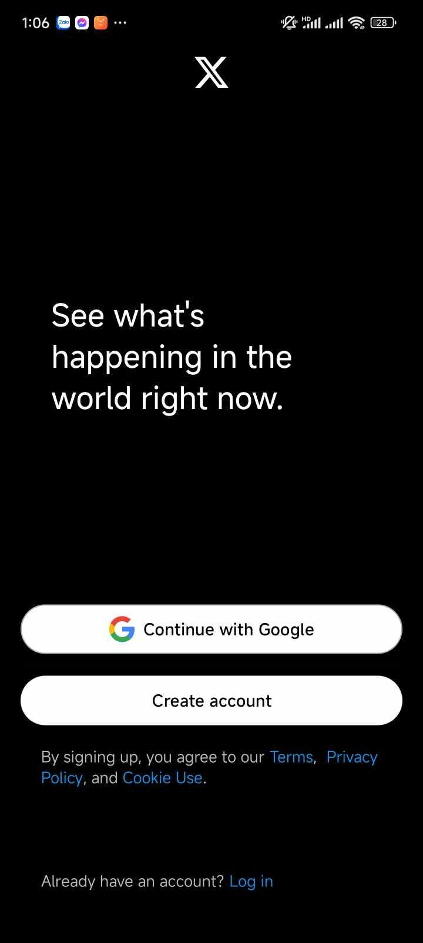
Login
Contain: Register page and Login Page

Slide 6
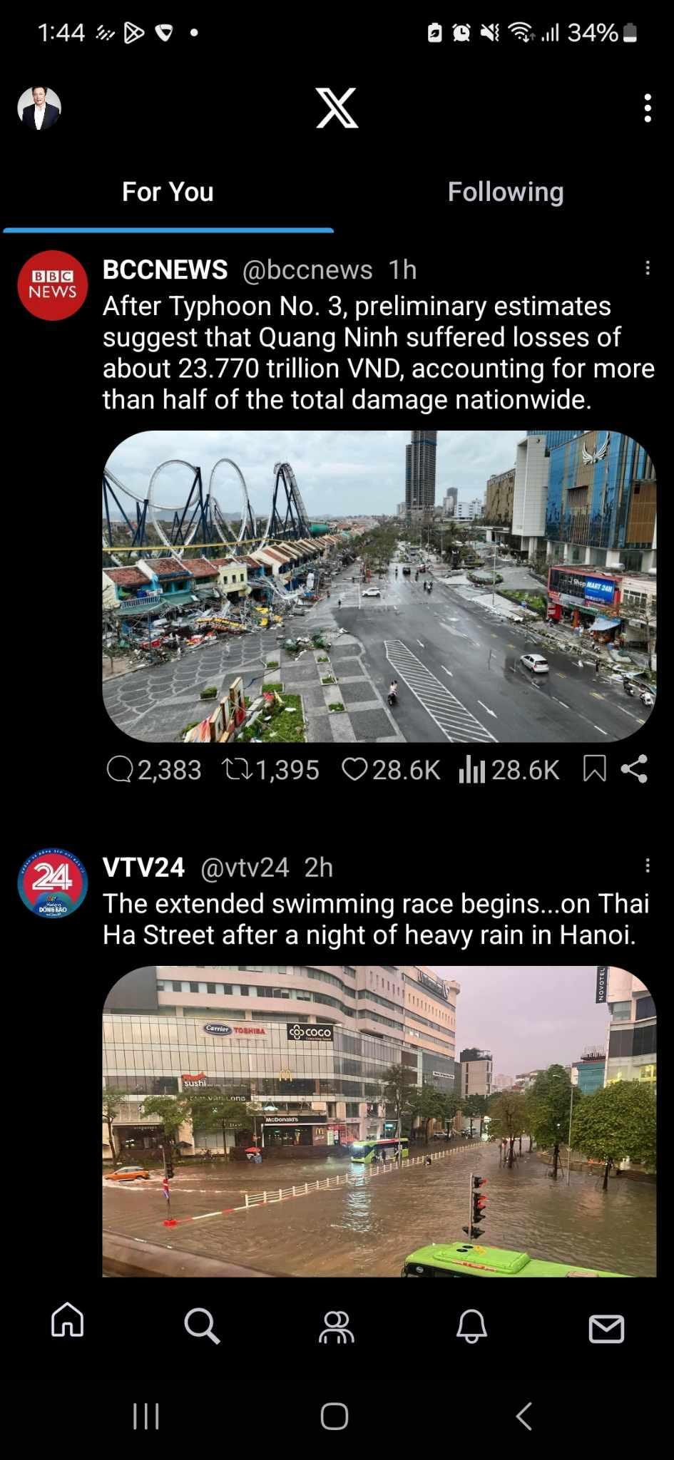
Home
Post constructor: includes profile picture, username, description and image
Interact with comment, heart and bookmark button

Slide 7
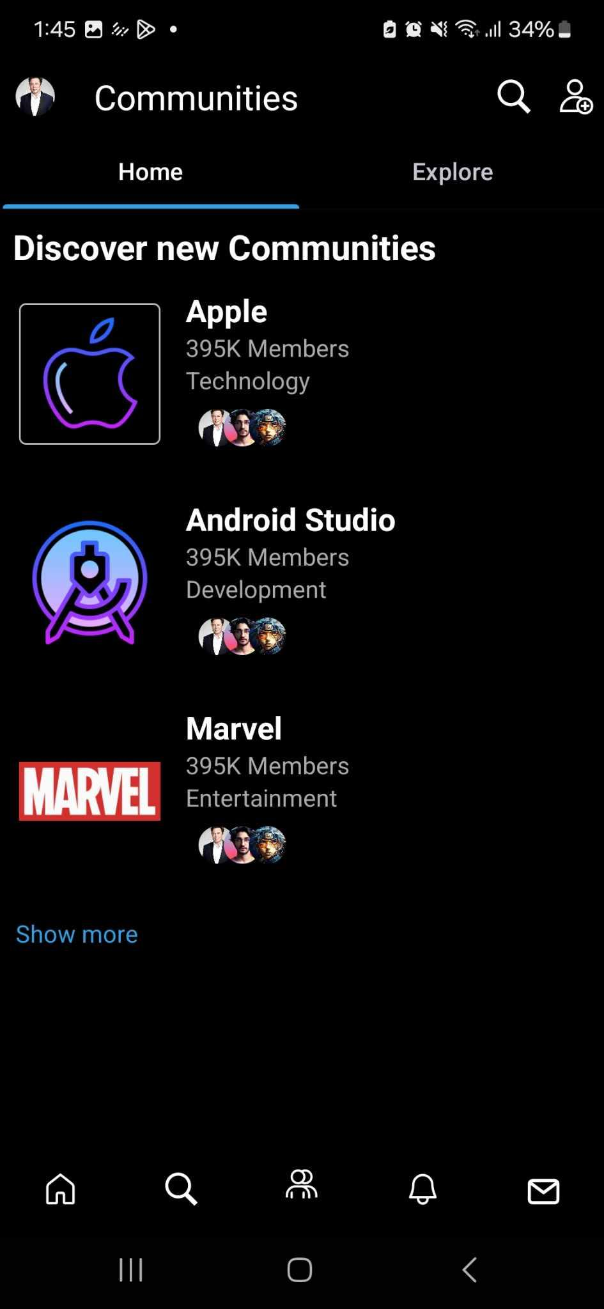
Community
Contain: Home page, Explore page and category
UX: Flip through Explore page and Home page, scroll horizontal posts

Slide 8
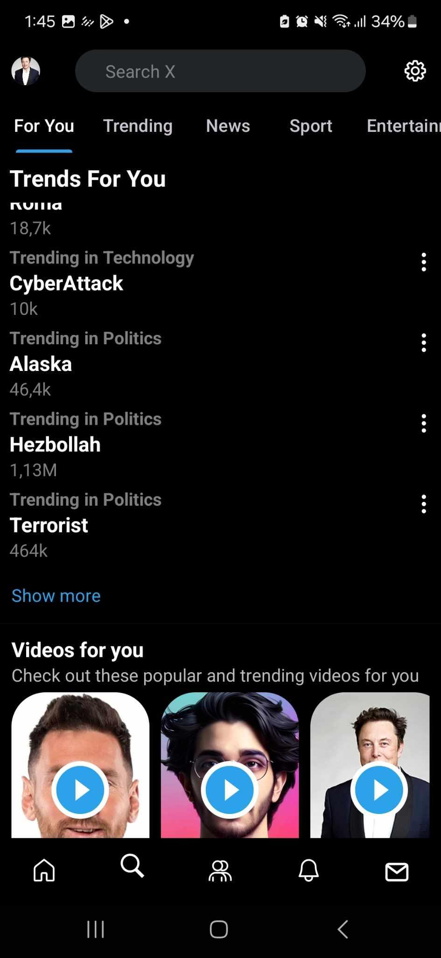
Search
Suggested Topics, content, video that many people search for or user may like

Slide 9
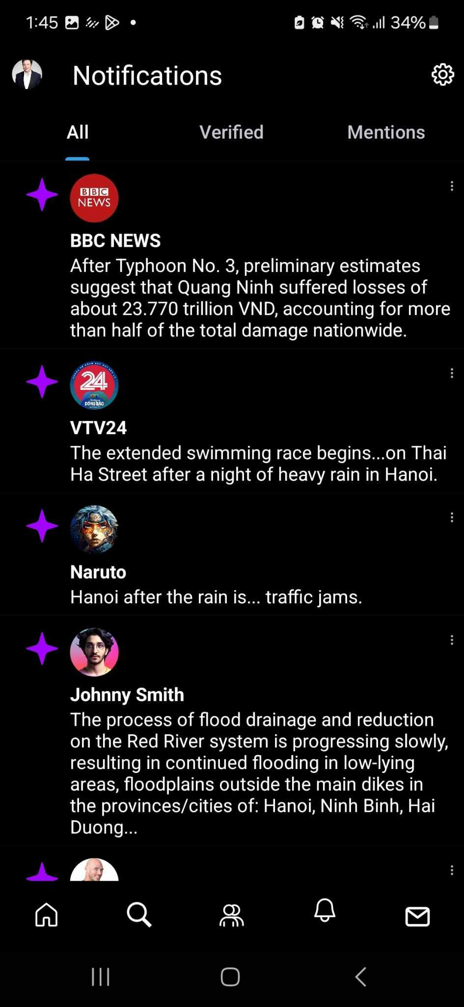
Notification
Notification for Tweets
Notification UI

Slide 10
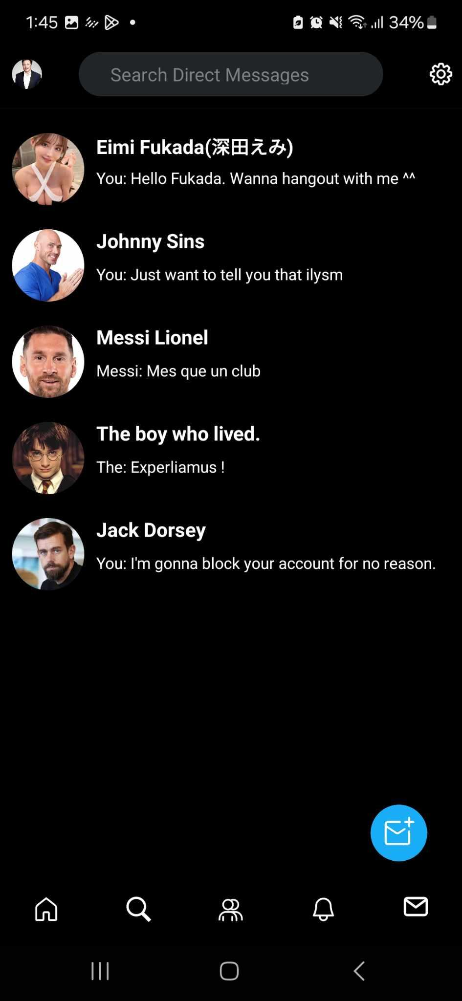
Chat Box
Search bar for direct messages
Inbox UI

Slide 11
02
Development

Slide 12
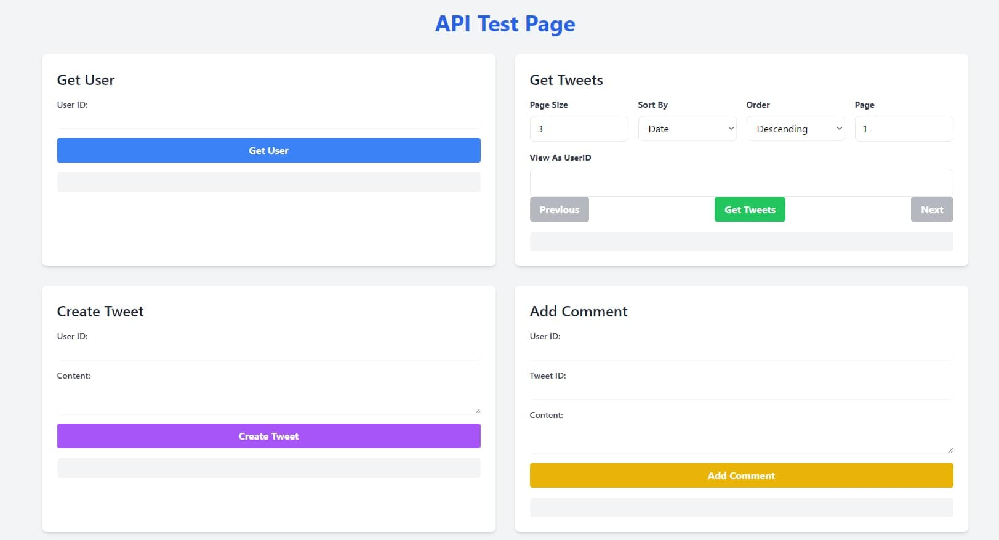

Slide 13
Login
Register: Create a new account
Login: Verify account authentication

Slide 14
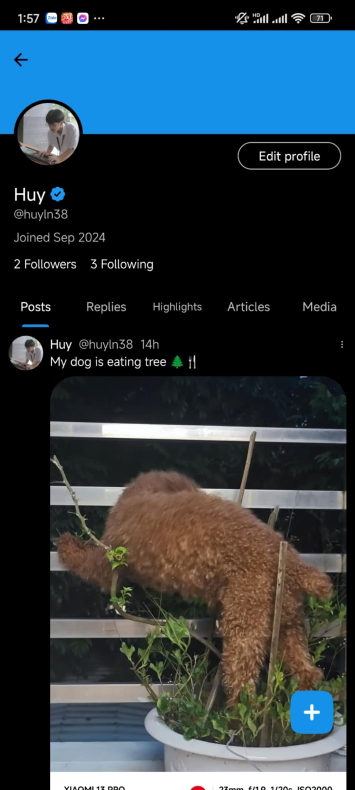
Profile
Show the information of user

Slide 15
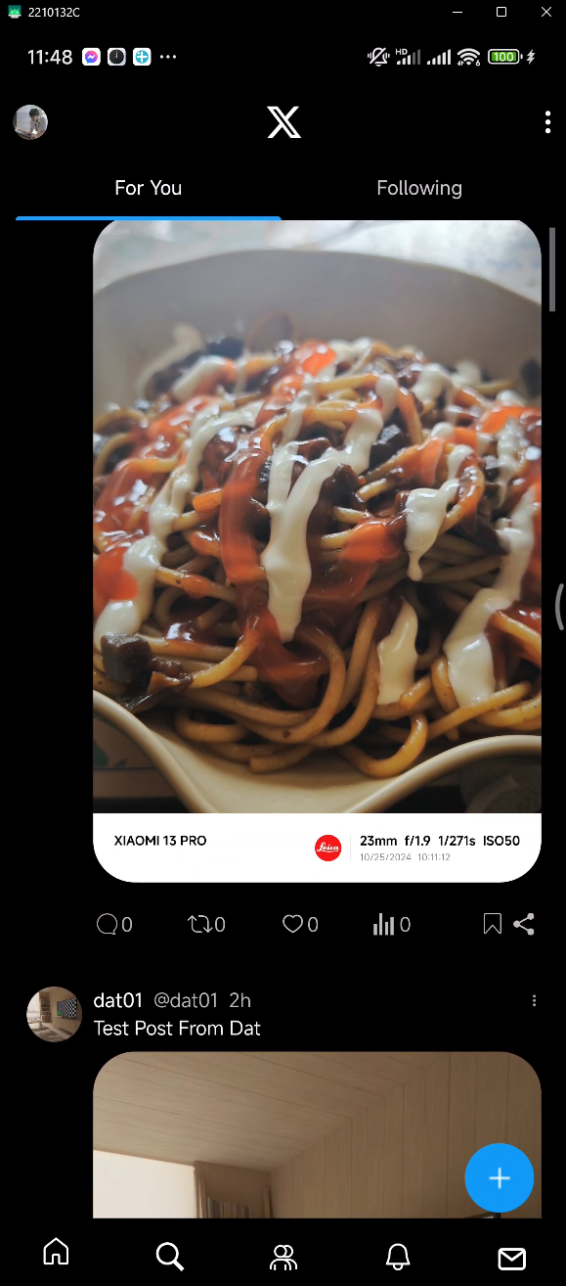
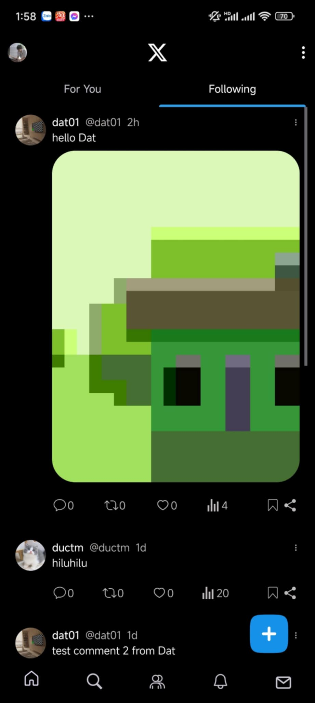
Home
Post a new tweet
Interact with heart button
Show the number of comments, like and views for the post
Follow the other user

Slide 16
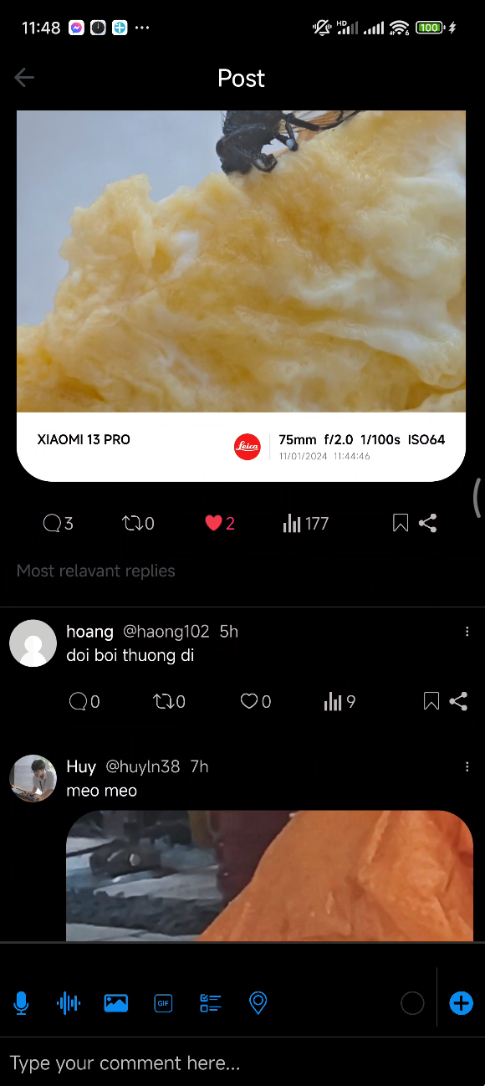
Comment
Show a list of comments corresponding to each tweet
Post comment

Slide 17
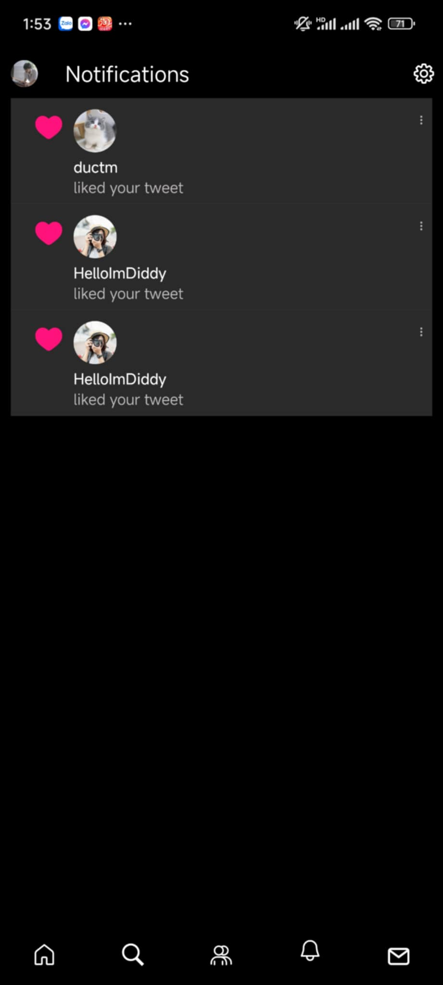
Notification
User get notification when other users interact with their post

Slide 18
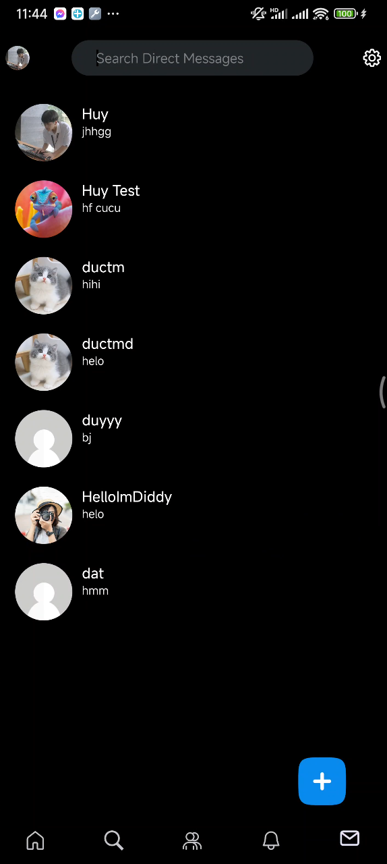
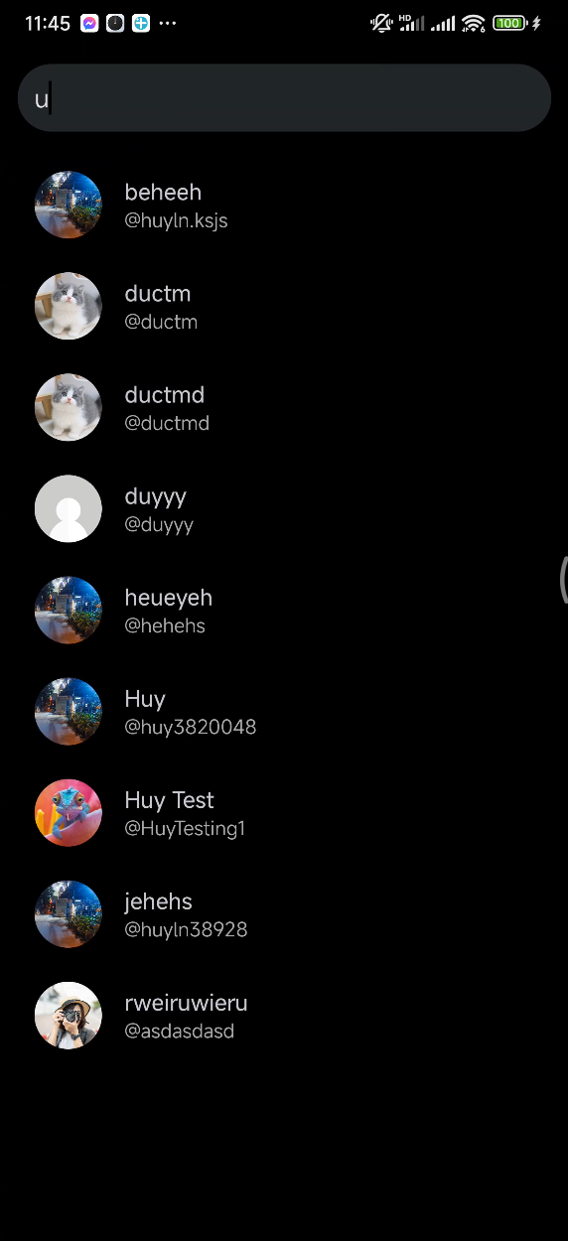
Chat Box
Search different users to make a conversation
Able to chat in real time

Slide 19
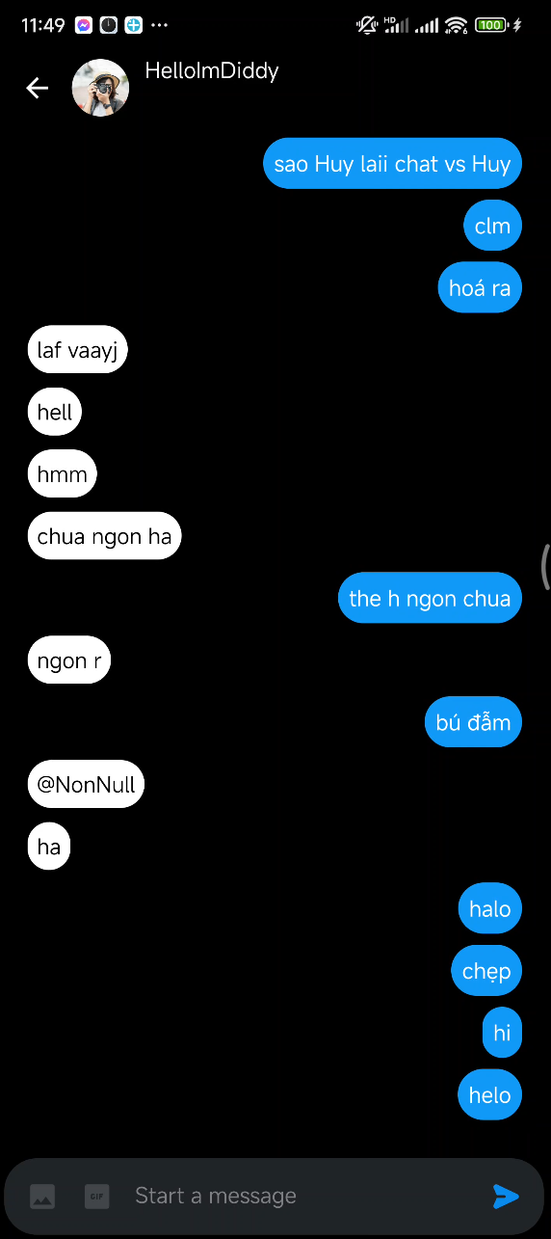
In Chat
User can send and receive messages in real-time with minimal delay

Slide 20
03
Conclusion

Slide 21
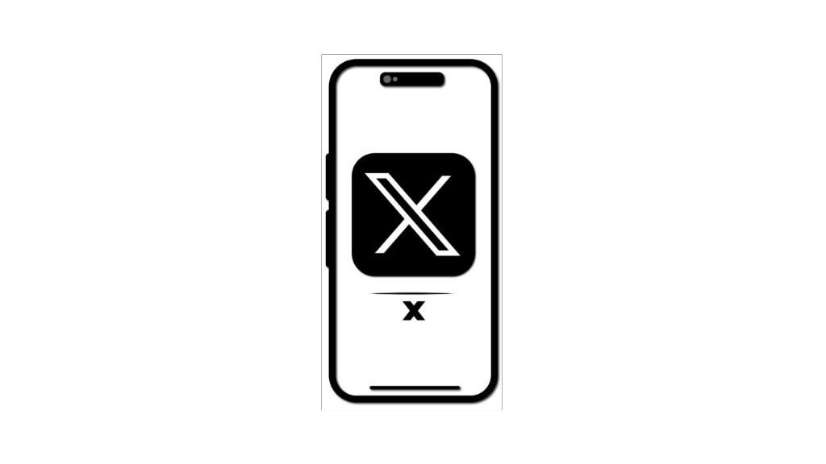
In The Future
Home: Develop an algorithms to suggest tweets that user is interesting
ChatBox: Develop the security of the conversation
Community: Can post and filter categories in Communities
Search: Search Bar for Future Queries

Slide 22
04
Demo

Slide 23
Thanks for listening!
Any question ?

